Slide 1









My Algebra – Solving Equations 2 Interactive Notebook
$$×$$
$$\frac{1}{2}$$
$$÷$$
$$+$$
$$−$$
$$\frac{3}{5}$$
$$7$$
Name
Class
Teacher
Term 2 Semester 1
$$5^{2}$$
$$\sqrt{9}$$

Slide 2
Contents
Glossary or Formula Page
Page
Date
Description
2

Slide 3
Tasks
24
7
30
Essential Question
Questions
Notes
Summary
6

Slide 4
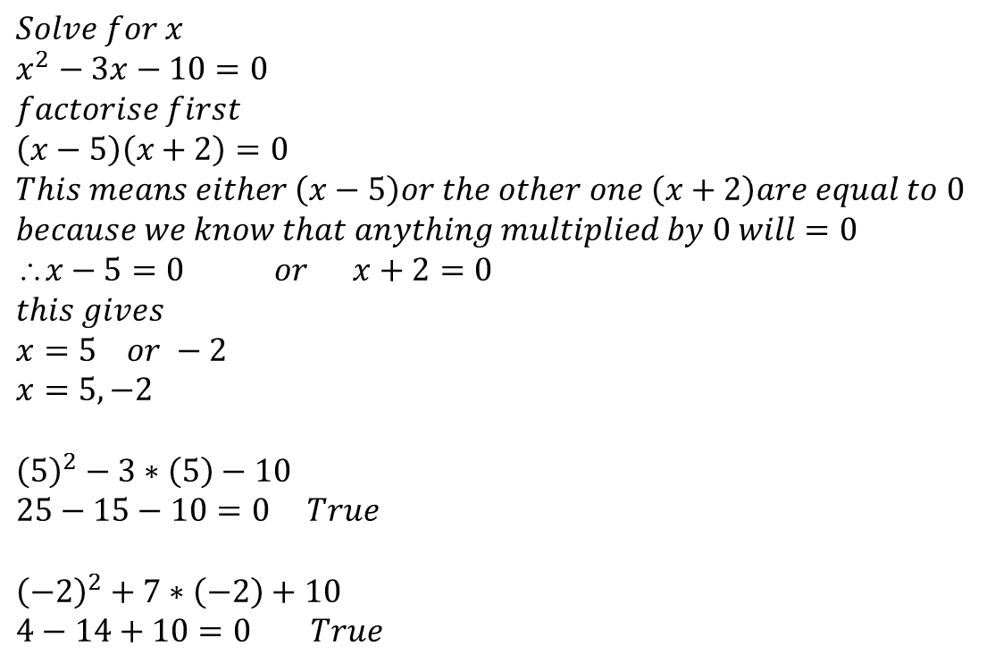
24
7
30
Date
Solving Equations?
EQ – How does “= 0” help?
$$Solve for x \\ x^{2}−3x−10=0 \\ factorise first \\ \left(x−5\right)\left(x+2\right)=0 \\ This means either \left(x−5\right)or the other one \left(x+2\right)are equal to 0 \\ because we know that anything multiplied by 0 will=0 \\ x−5=0 or x+2=0 \\ this gives \\ x=5 or −2 \\ x=5,−2$$
$${\left(5\right)}^{2}−3∗\left(5\right)−10 \\ 25−15−10=0 True$$ $${\left(−2\right)}^{2}+7∗\left(−2\right)+10 \\ 4−14+10=0 True$$
Lets make our equation = 0!
We must have either of these two brackets equalling zero

Slide 5
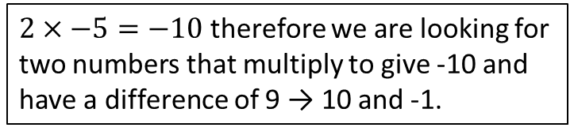
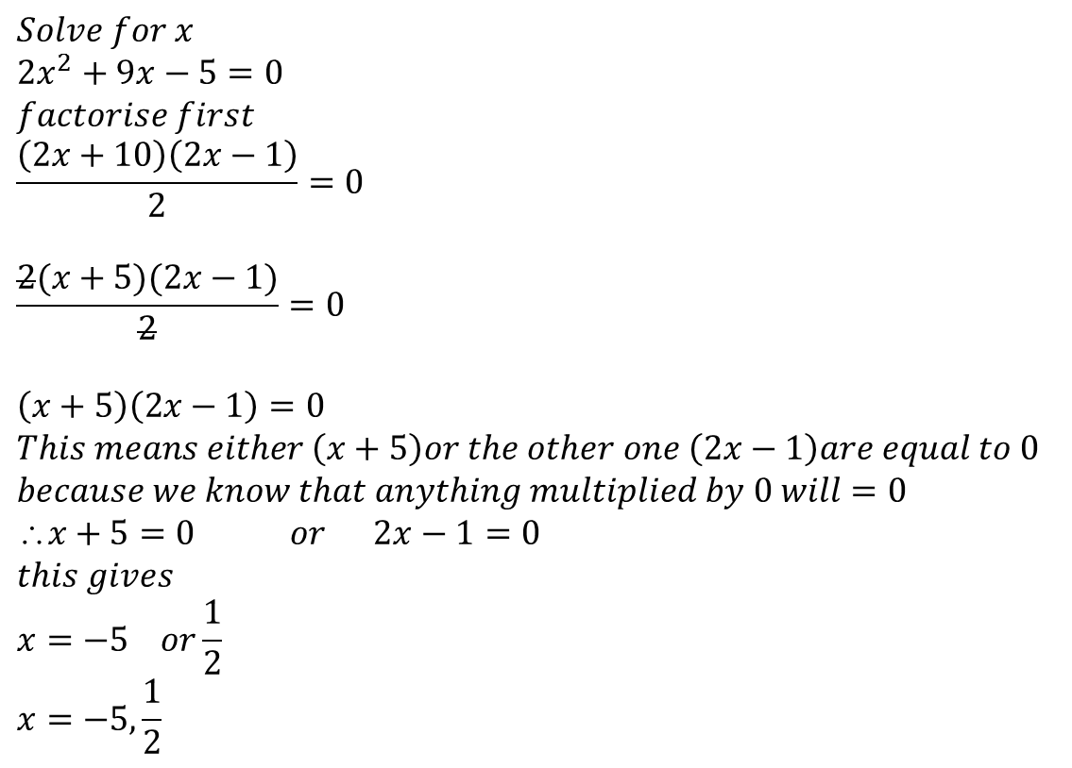
24
7
30
Date
Solving Quadratic Equations?
EQ – How does “= 0” help?
$$Solve for x \\ {2x}^{2}+9x−5=0 \\ factorise first \\ \frac{\left(2x+10\right)\left(2x−1\right)}{2}=0$$
$$\frac{2(x+5)(2x−1)}{2}=0$$
$$\left(x+5\right)\left(2x−1\right)=0 \\ This means either \left(x+5\right)or the other one \left(2x−1\right)are equal to 0 \\ because we know that anything multiplied by 0 will=0 \\ x+5=0 or 2x−1=0 \\ this gives \\ x=−5 or\frac{1}{2} \\ x=−5, \frac{1}{2}$$
$2×−5=−10$ therefore we are looking for two numbers that multiply to give -10 and have a difference of 9 → 10 and -1.
Lets make our equation = 0!

Slide 6
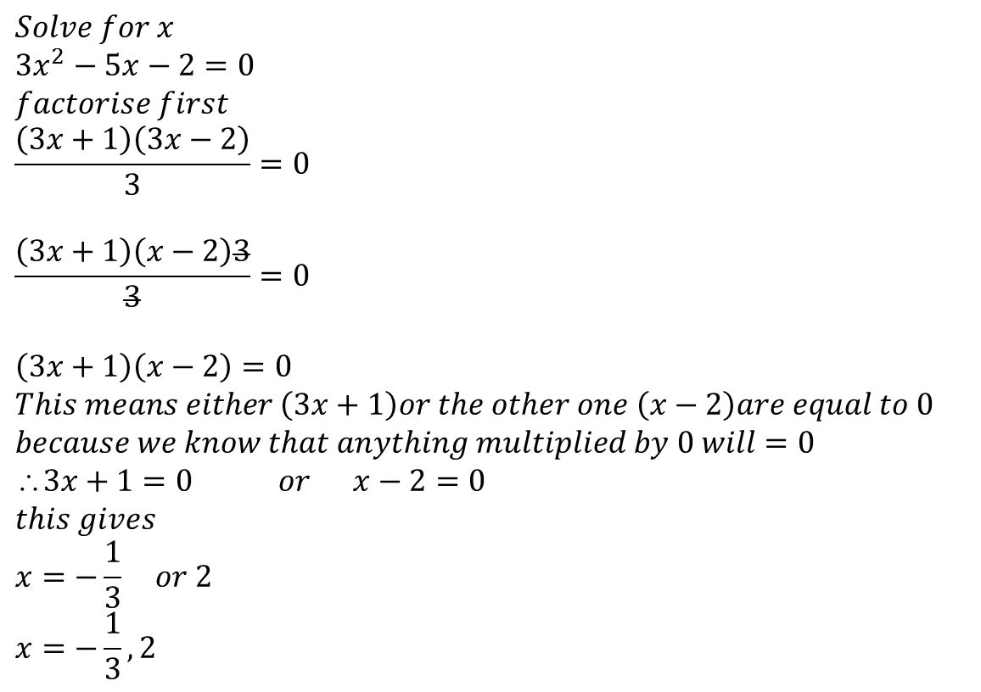
24
7
30
Date
Solving Quadratic Equations?
EQ – How does “= 0” help?
$$Solve for x \\ {3x}^{2}−5x−2=0 \\ factorise first \\ \frac{\left(3x+1\right)\left(3x−2\right)}{3}=0$$
$$\frac{\left(3x+1\right)\left(x−2\right)3}{3}=0$$
$$\left(3x+1\right)\left(x−2\right)=0 \\ This means either \left(3x+1\right)or the other one \left(x−2\right)are equal to 0 \\ because we know that anything multiplied by 0 will=0 \\ 3x+1=0 or x−2=0 \\ this gives \\ x=−\frac{1}{3} or 2 \\ x=−\frac{1}{3},2$$
Lets make our equation = 0!

Slide 7
24
7
30
Date
Perfect Squares and solving by completing the Square
EQ – What is completing the square?
The key is to note that in the original quadratic, the third term is always the square of half the coefficient of x. The coefficient halved also helps give us the factorised form. For example in the perfect square x²+6x+9, halving the x coefficient 6 gives us 3, which gives us the third term 9 when squared. That means we can factorise the quadratic to (x+3)². This is another way to look at the relationship shown with a drawn square in the video. We can use this knowledge to factorise irregular monic quadratics into the form (x+a)²+b, where a and b are any numbers.
For example, x²-8x+5 is not a perfect square, but we can use part of it to form one. Looking at just the first two terms we have x²-8x. If this was part of a perfect square what would be the third term?
Let's follow our previous technique by halving and then squaring the x coefficient. (-8÷2)²=(-4)² = 16, which should be the third term.
x²​-8x+5 = (x²​-8x+16)+5−16
= (x+4)²+5−16
= (x+4)²−11 That’s done or partly factorised!
Note these notes are the same as from Chapter 6 but using different examples

Slide 8
24
7
30
Date
Perfect Squares and solving by completing the Square
EQ – What is completing the square?
What now if I have to solve this quadratic like the one on the previous page
X²-8x+5 =0 ⇒ x²​-8x+5+11=11
⇒ (x-4)² = 1
⇒ (x-4)² = ±√11
⇒ x = 4±√11 x ≅ 0.68 or x ≅ 7.32
Need to make this 16 so add 11 to both sides.

Slide 9
24
7
30
Date
Perfect Squares and solving by completing the Square
EQ – What is completing the square?
Let’s now try to solve this quadratic equation!
x²​+7x-5 =0 ⇒ x²​+7x-5+17.25 = 17.25
⇒ (x²+7x+12.25) = 17.25
⇒ (x+3.5)² = 17.25
⇒ x+3.5 = ±√17.25
⇒ x = -3.5±√17.25 x ≅ -7.65 or x ≅ 0.65
7÷2 = 3.5
3.5² = 12.25
∴ Need to make -5 a 12.25 so we need to add 17.25.

Slide 10
Exercises
Exercise 7.4 & 7.5 from Dwyer
And the Yr 10A Completing the Square from Mathspace
All to be done with a smile on your faces.

Slide 11
Notes Review
24, 7 ,30
Date
Title
Essential question
Notes complete
Notes complete with colour and diagrams
Questions completed
Contents page filed in
Formula page filled in

Slide 12
Homework
Review your notes and write a summary answering the essential question.

